Slide 1
Note to teachers:
The following slides offer an introduction to the Tools approach and examples of how it works in the classroom. Feel free to incorporate these slides into your own presentation, and add your own classroom photos.
At the end are some suggestions for activities parents can do before or after your presentation.

Slide 2

WELCOME!
PreK
Back to School Night

Slide 3
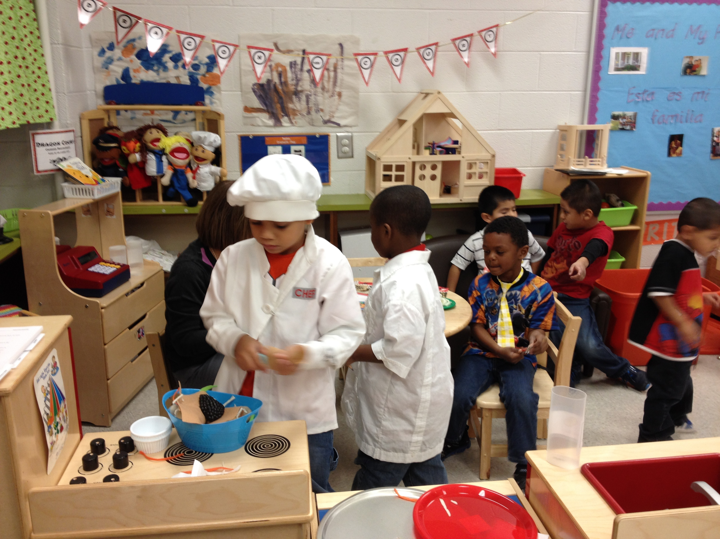
What makes
Tools of the Mind
unique?
All activities are designed to give children practice in developing self-regulation
Make-believe play is a specific focus
Children talk more, teachers talk less
Notes:
Teacher: Like any curriculum, Tools of the Mind meets all state and national standards, and teaches children all subjects.
What’s different about Tools is that every single activity is designed to give children practice in developing self-regulation—so children develop self-regulation while learning letter names, and while learning to count, and while doing make-believe play.
And play is another big aspect that makes Tools different—make-believe play is a focus. We know that children do their best learning when engaging deeply in play.
(The children in the photo are at a Restaurant Center during Make-Believe Play.)
We also set up every activity so kids talk more, and teachers talk less. Children need to talk to think, so we get them talking a lot—whether during Make-Believe Play or math activities.

Slide 4
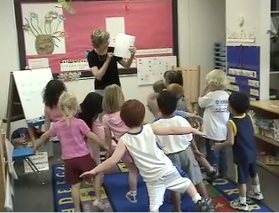
What is self-regulation?
Self-regulation and executive functions are abilities that allow children to be successful in social interactions and learning.
Example abilities:
Sitting still, hands to self
Taking turns, sharing, managing emotions
Staying focused, completing tasks
Notes:
Teacher: So, what is self-regulation anyway?
Self-regulation—also called executive functions—is what we’re using using when we act in an intentional way, on purpose. It is something you use when you’re trying to solve problems, figuring out how to handle a social situation, or are confronted with learning new things. It isn’t what you use when you are brushing your teeth or doing something you do as a habit.

Slide 5
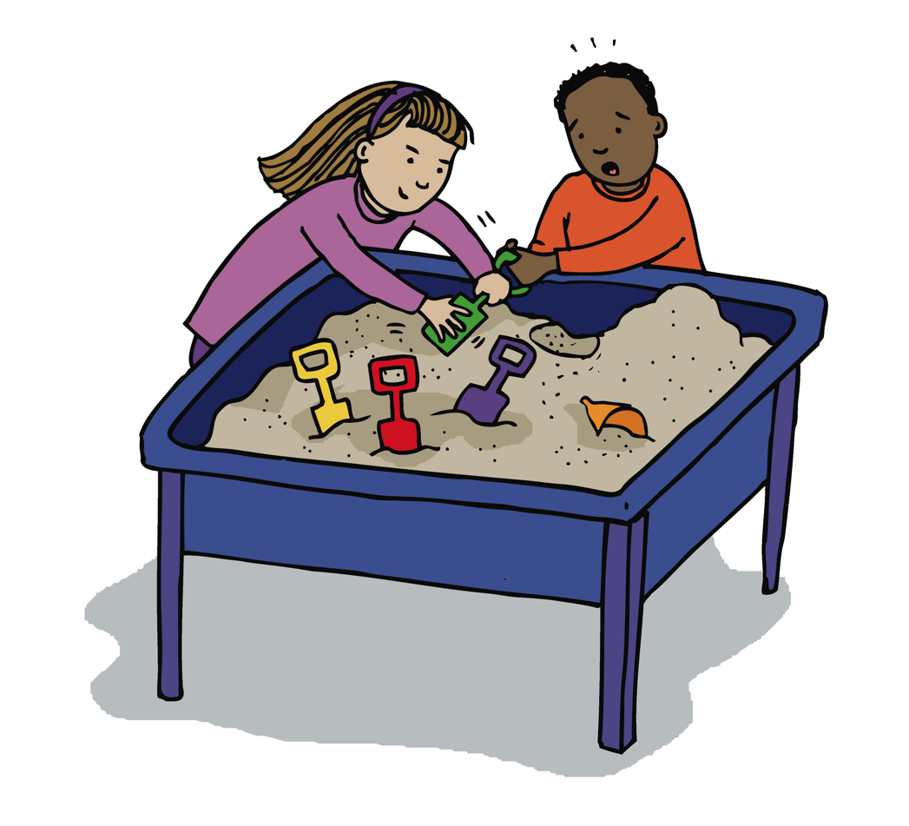
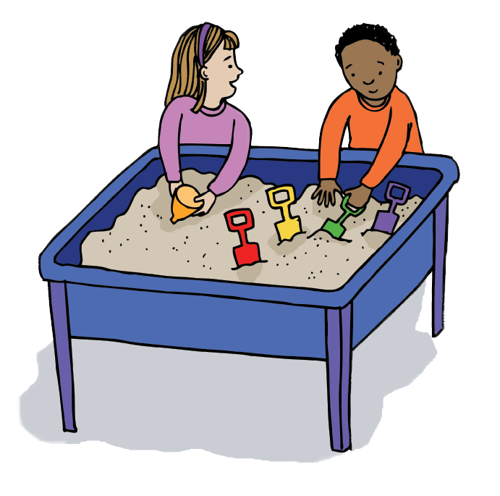
Without self-regulation
With self-regulation
Children have a hard time waiting, sharing materials and toys.
They may know the rules but can’t yet inhibit behaviors like grabbing or pushing.
Children can take turns, share materials, and wait for their turn. They can use strategies like asking for something they want, or playing with something else while they wait.
Notes:
Teacher: Here is a set of 3 slides with examples to help you understand what self-regulation is.

Slide 6
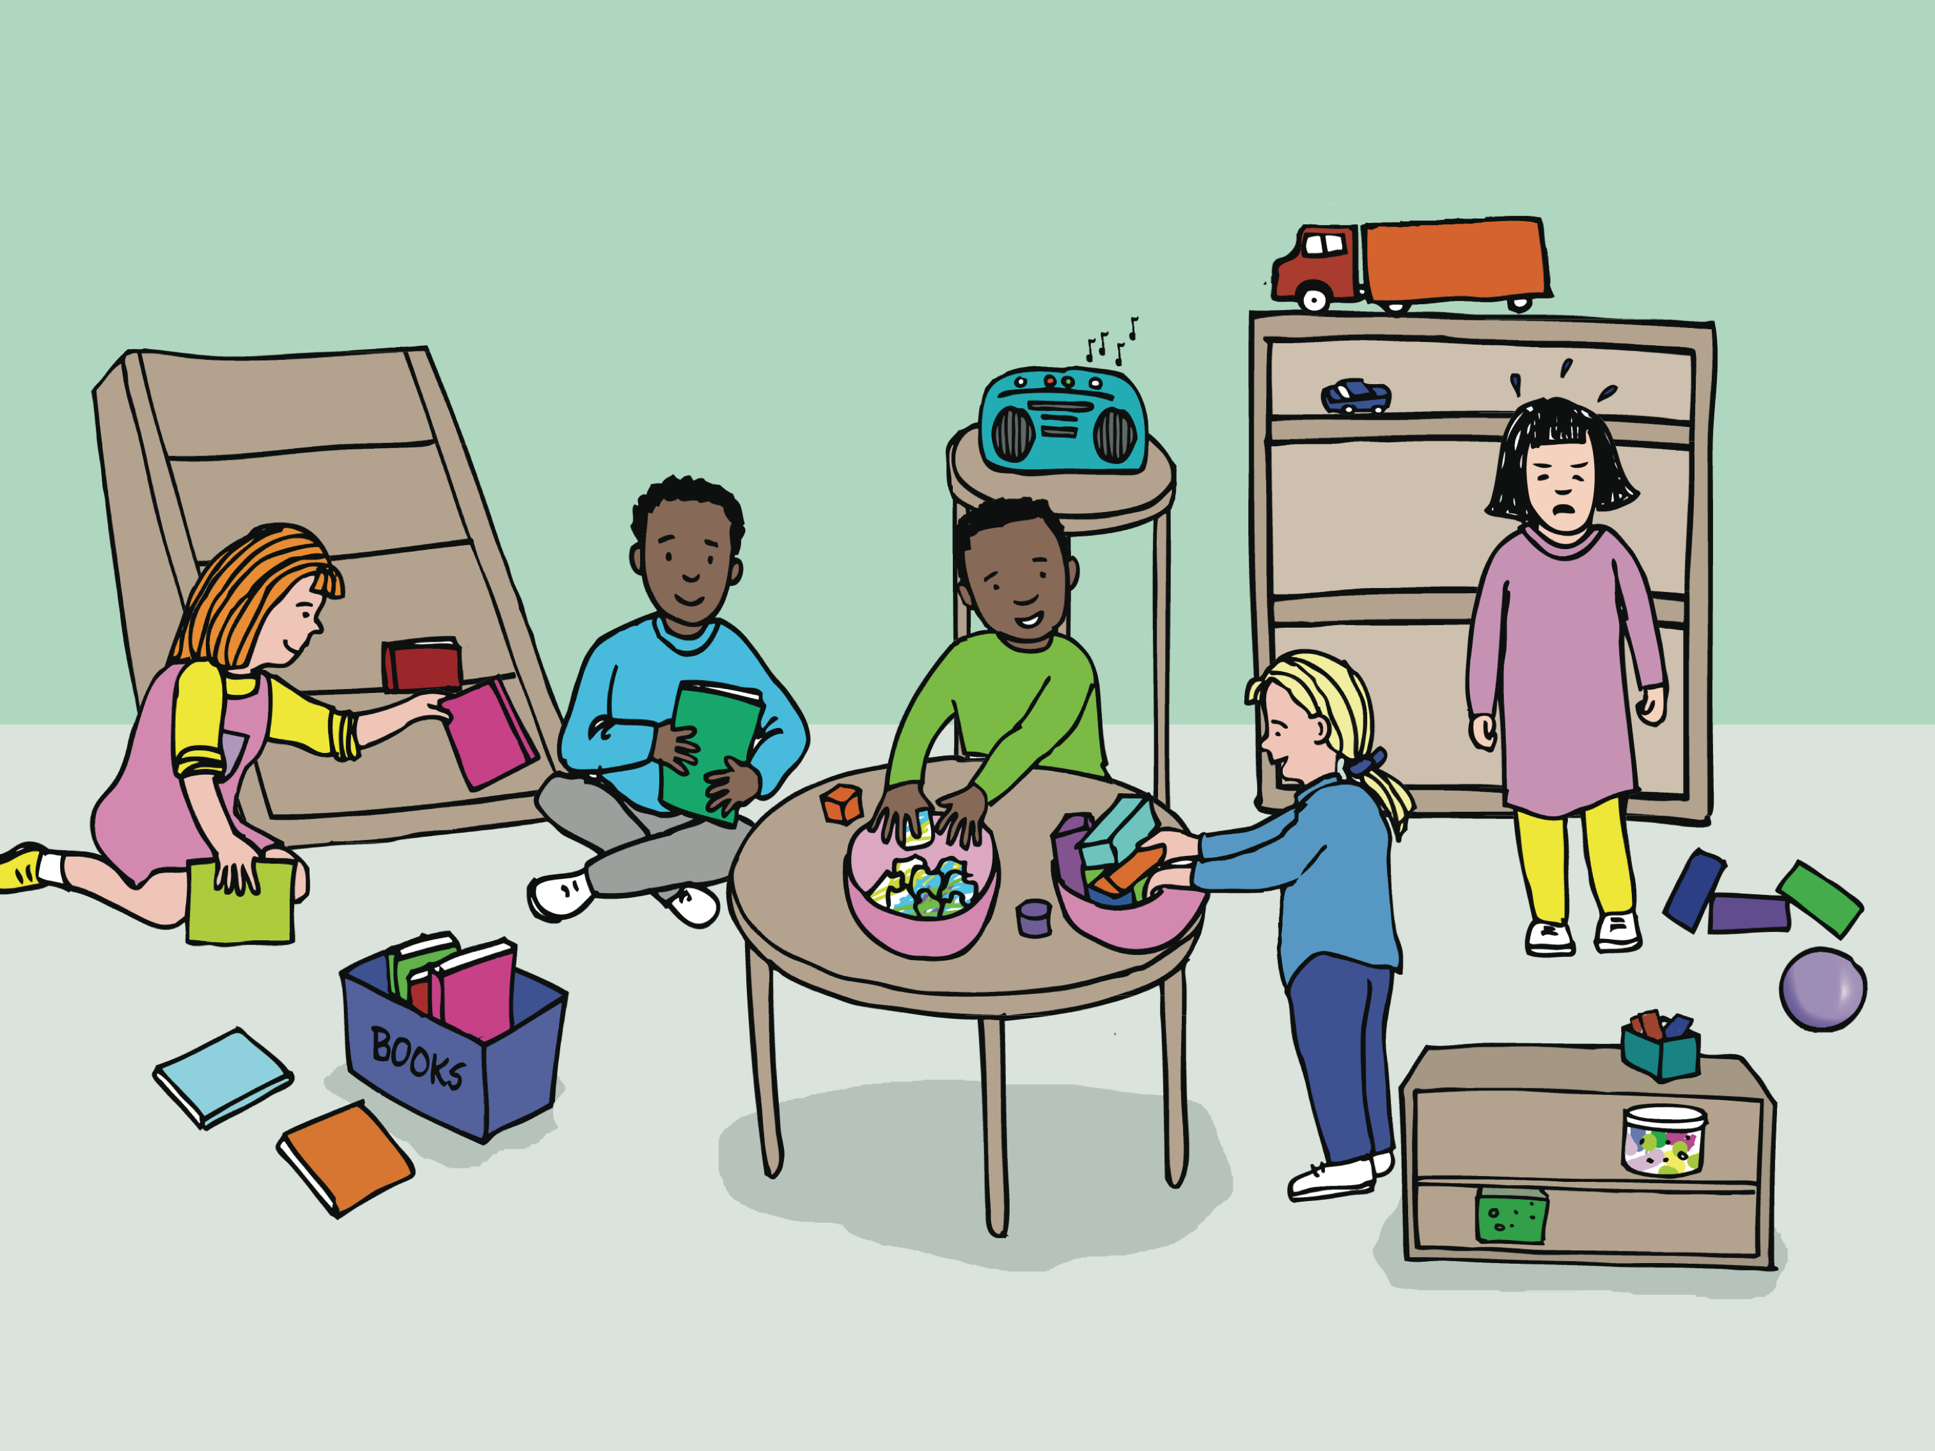
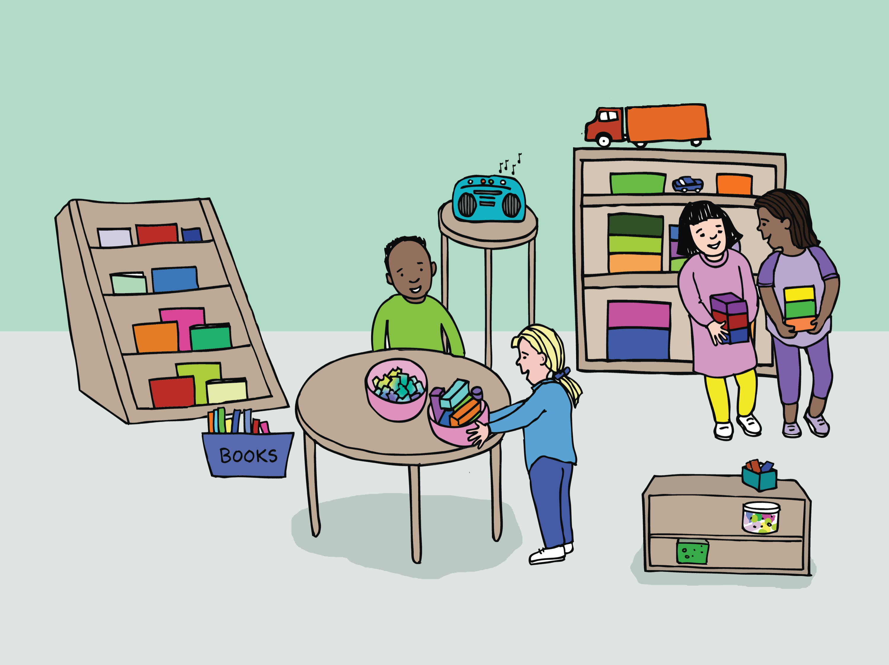
Without self-regulation
With self-regulation
Children have a difficult time with transitions like clean up or bedtime – ending something they want to do and doing something they don’t want to do! They may melt down, and find it difficult to stop and transition.
Children can manage a transition like bedtime or clean up time, even when they are disappointed that a fun time is coming to an end. Young children may still need support–but self-regulation is what’s needed to be successful at this.

Slide 7
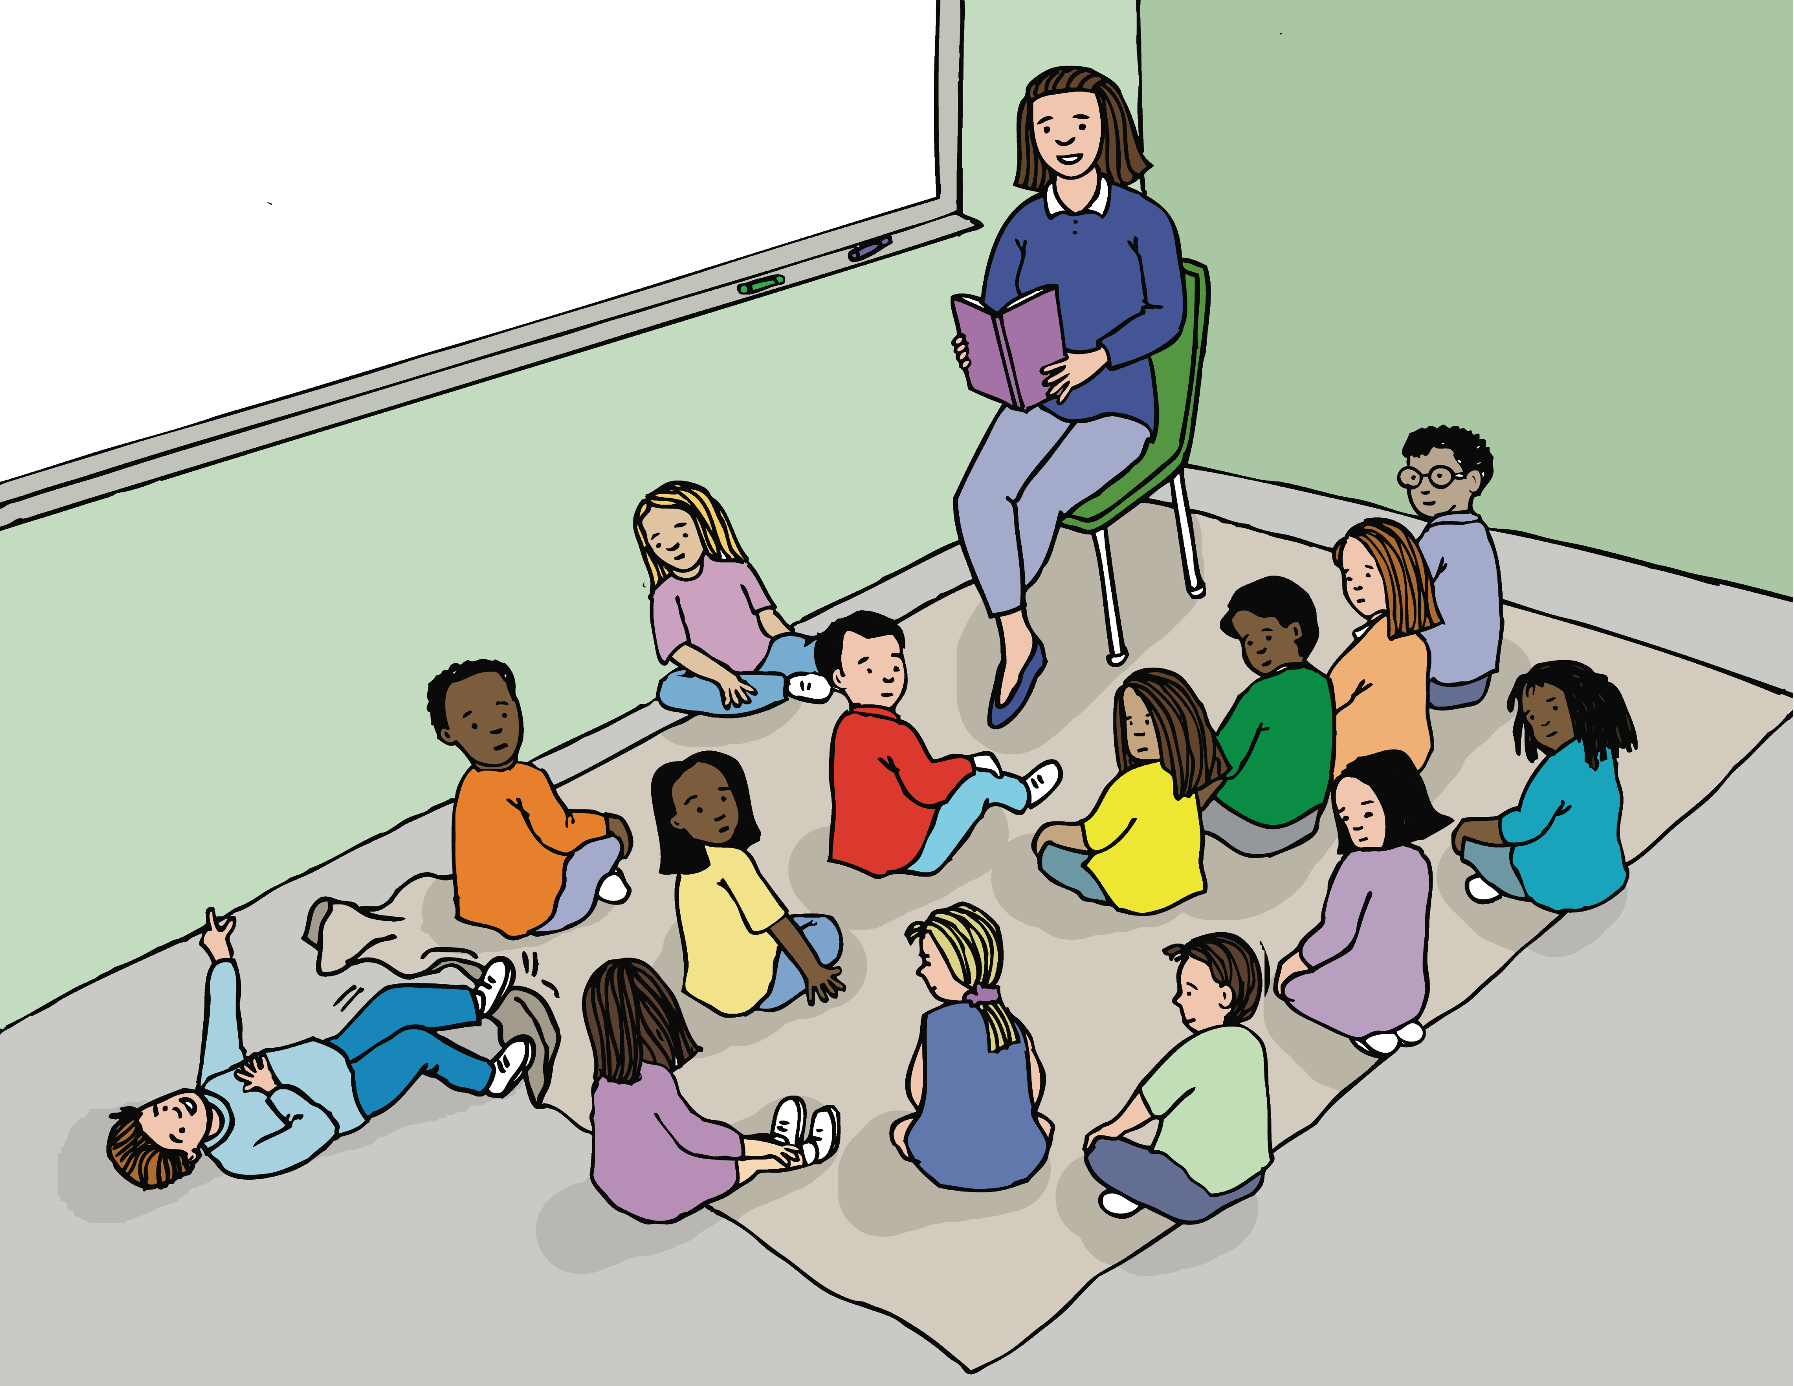
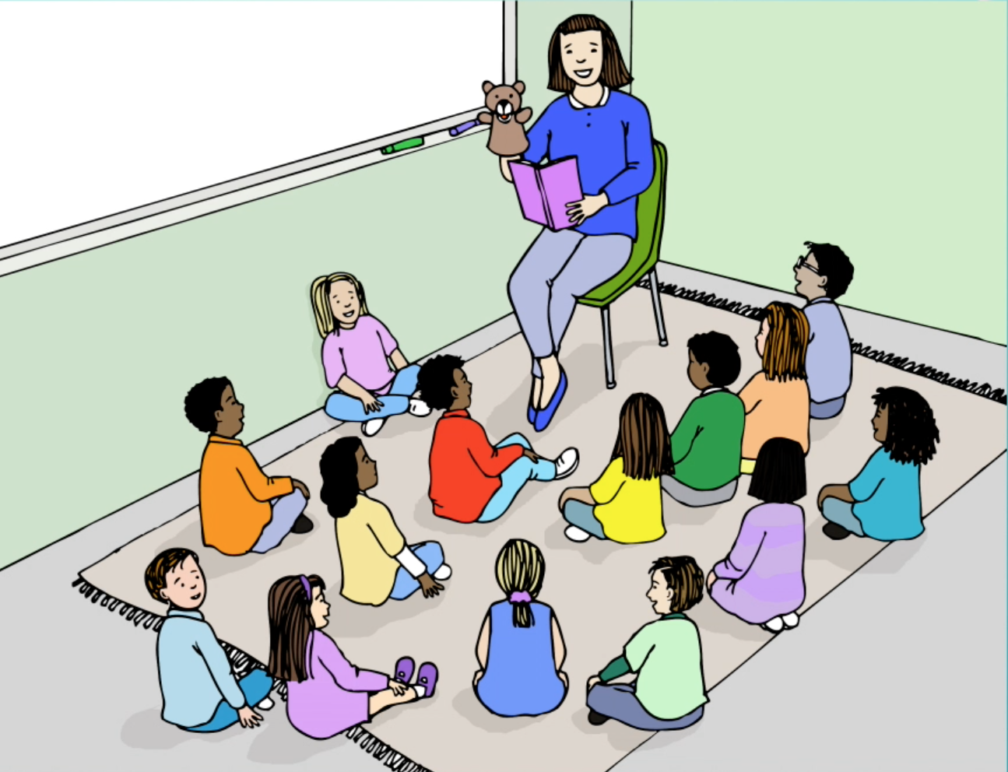
Without self-regulation
With self-regulation
Children without self-regulation may not be able to stay seated and listen to a story, sit through dinner or a game.
Children can control their attention enough to listen to a story, play a game, and sit through a meal. Their attention may wander, but they can bring it back to the task at hand.
Notes:
Teacher: You might want to say something here about the fact that children are developing these skills—it’s a job of childhood!—and they won’t master them for a while. But it’s the direction they’re headed in, and the Tools approach supports them in getting there.

Slide 8
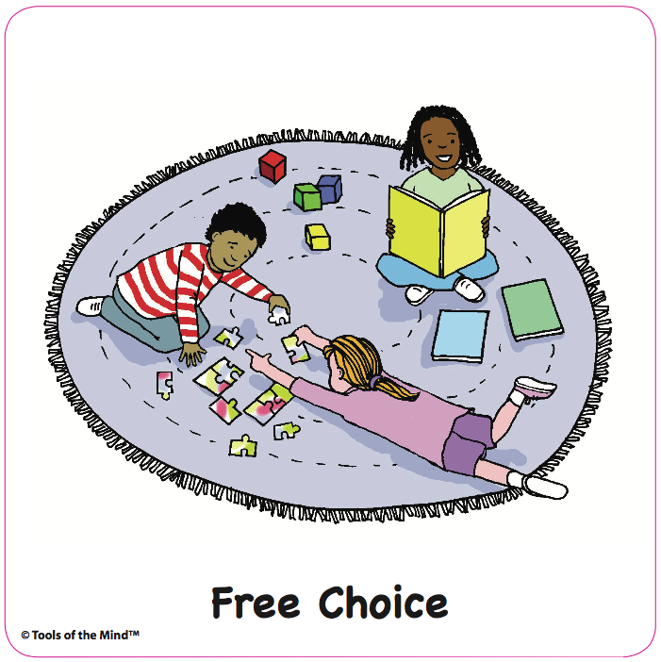
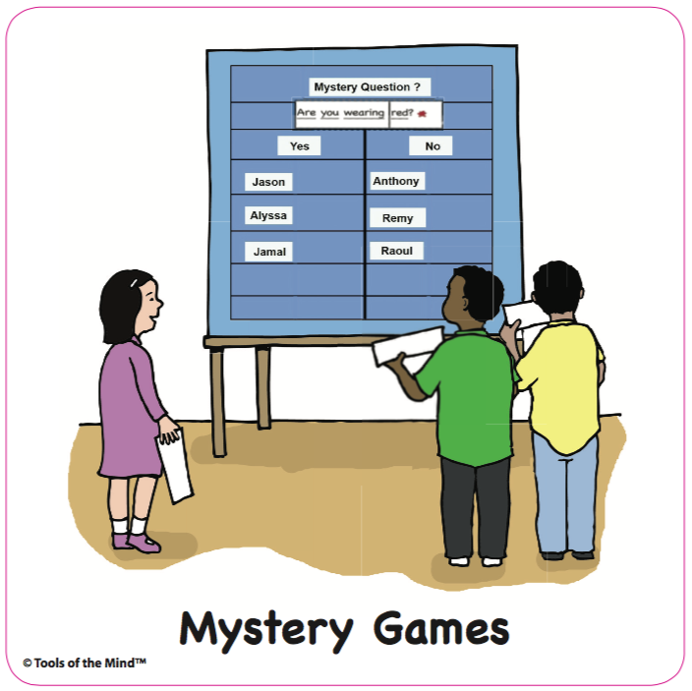
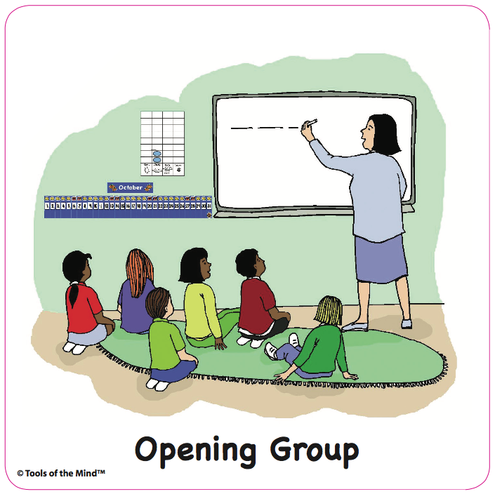
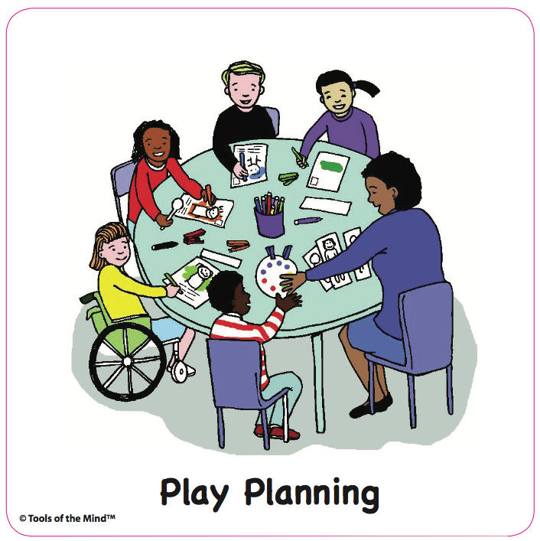
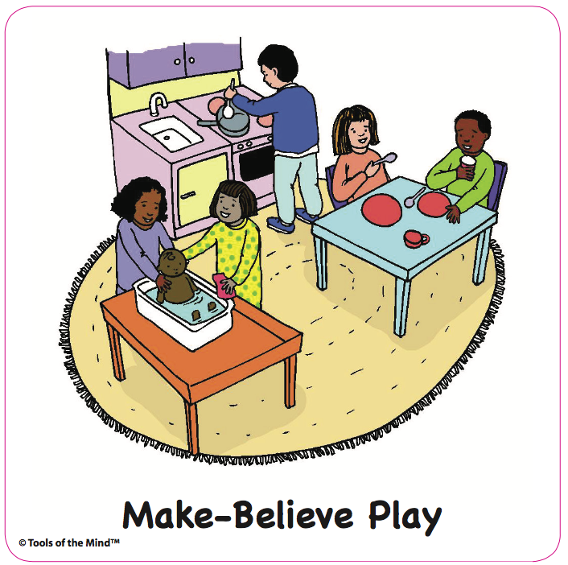
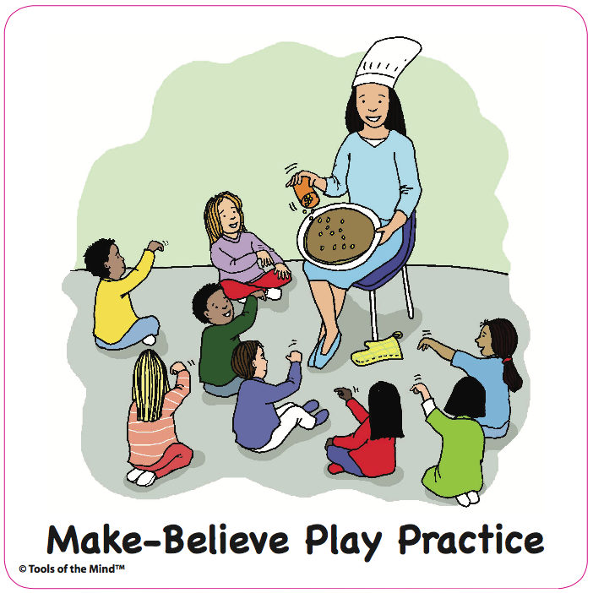
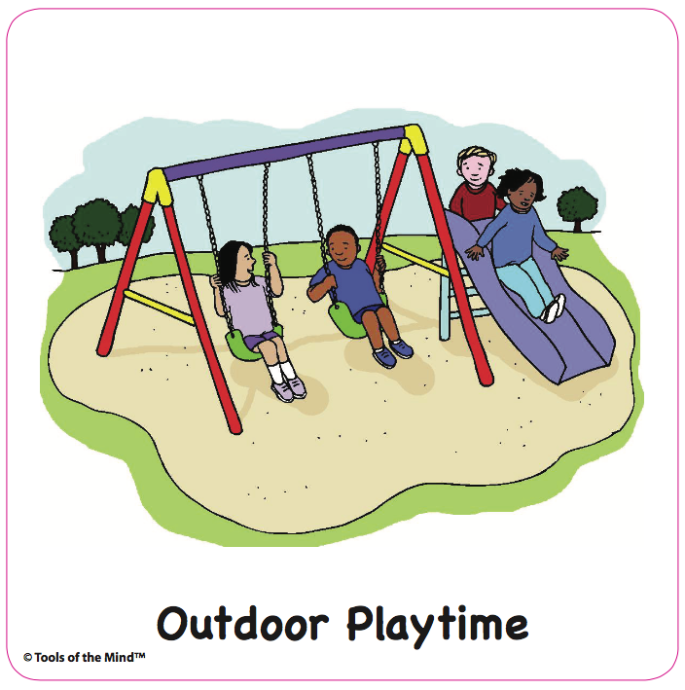
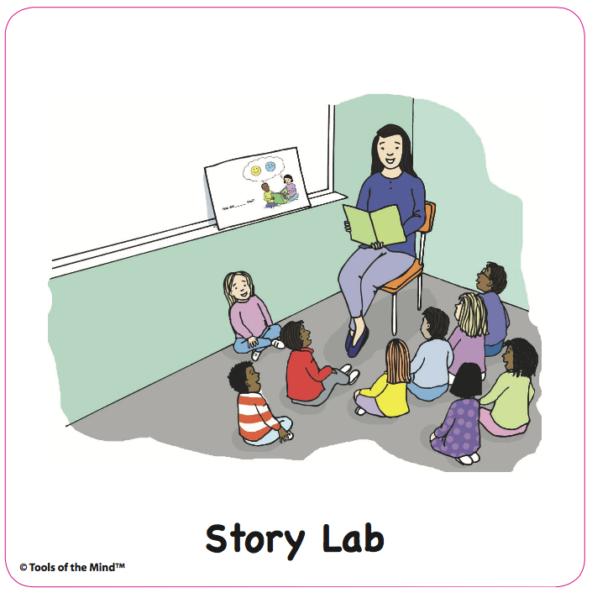
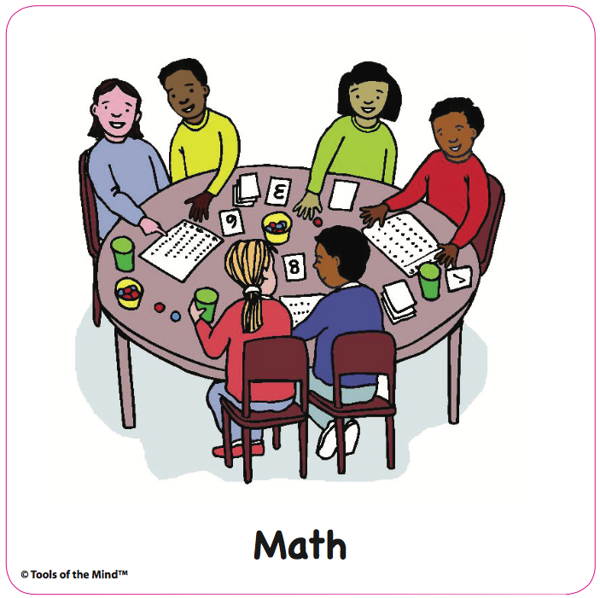
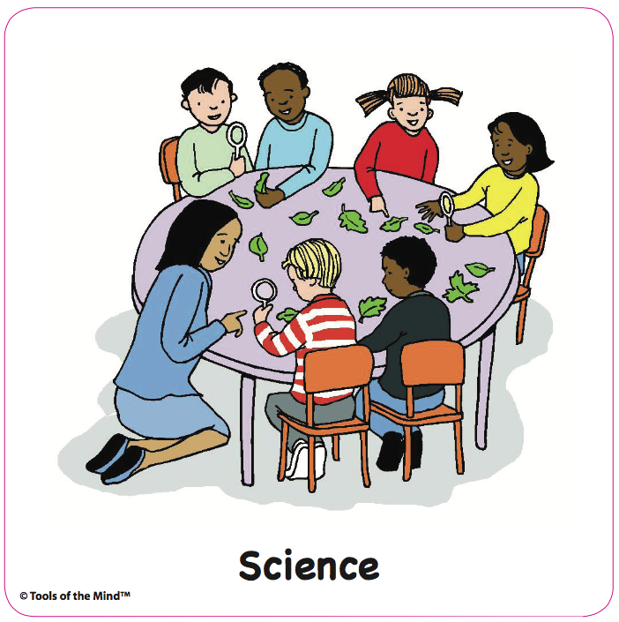
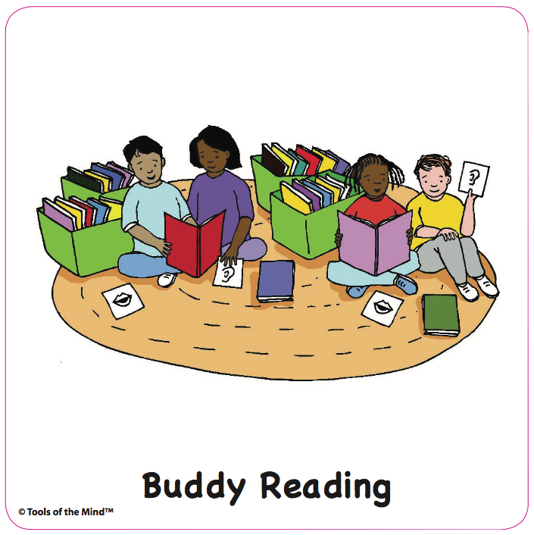
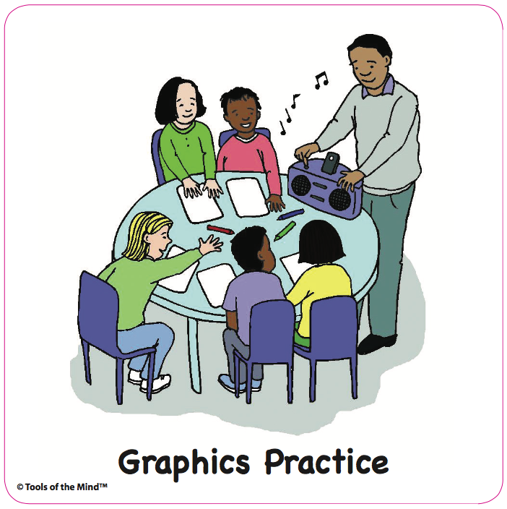
What is a typical Tools PreK day?
Daily Schedule
Notes:
Teacher: (You may want to modify this slide to look like your schedule, or put a photo of your own class schedule here.)
A Tools school day looks a lot like any other PreK school day! But again, children are developing self-regulation in every activity, and doing lots of talking to think and learn.
Let’s look at some example activities from across the school day.

Slide 9
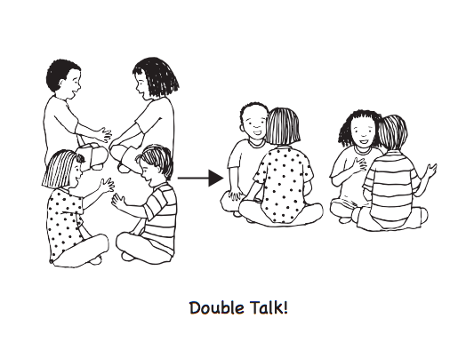
Example Activity:
Share the News
Notes:
Teacher: Do you remember doing show and tell as a child? Having to wait weeks and weeks for your turn to share? Having to work hard to stay quiet while listening to someone else talk for a long time? Share the News is Tools’ version of sharing…where all children get to talk and share every day.
Each day during Opening Group there’s a new Share the News topic. At first the topics help us get to know each other—like, What is your favorite dessert? As the year goes on, we might use Share the News for social learning and for academic learning. The question could be, When two kids both want the same marker, how can they solve the problem? Or, we know the letter B makes the sound “buh.” Tell a friend a word that starts with the sound “buh.”
Let’s try it together now. First, you need a partner. Find a partner, hopefully someone you don’t know yet! Take a minute now to do that. You want to sit or stand face to face with them.
Listen to today’s topic. It’s, What do you want your child to learn this year in Pre-K? Let’s say it together—What do you want your child to learn in Pre-K? Take a moment to think about what you’ll say. When you know, put a thumb up to show me you’re ready. Okay, now share with your partner.
(you can ring a chime or do a hand clap to call their attention back) I heard parents say (share a few things you heard). Notice I don’t share everything I heard—just a few—so we can move right along to the next activity. Now we’re going to do a Double Talk! Go find another partner to share with—again, someone you don’t know. You’re going to tell them what you want your child to learn this year in Pre-K.
(share a few more things you heard parents say)
You just practiced lots of skills: you found a partner, you took turns, you had to think about how to put your idea into words, and hold your idea in mind while your partner talked. There was a lot of self-regulation practice built into that one activity.

Slide 10
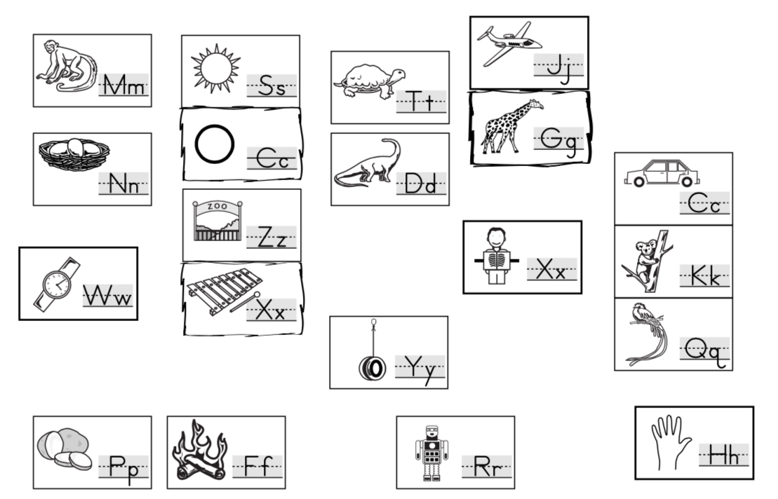

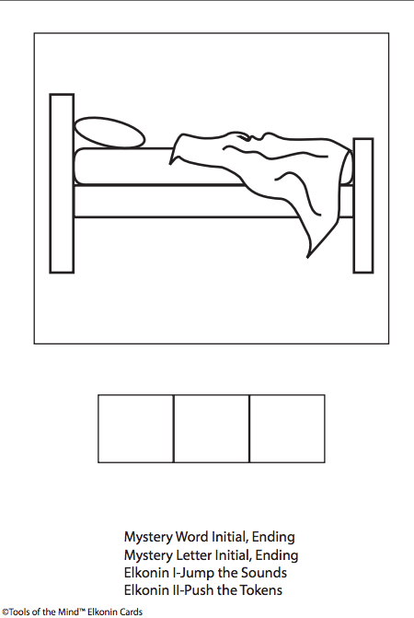
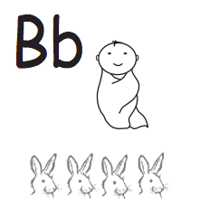
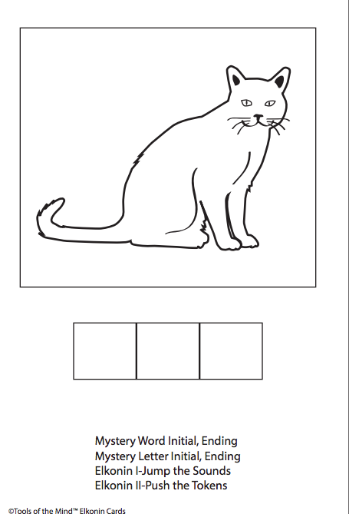
How do we help children develop foundational skills in
reading & writing?
Daily writing activities, use of Sound Map:
We are going to jump.
Games & small group practice for learning letter names
and sounds:
Notes:
Teacher: We develop foundational reading and writing skills every day through a variety of activities. Children engaged in both shared and individual writing experiences that start with children drawing their ideas (examples left to right are Message of the Day and play plan). The unique Sound Map helps children locate letters by knowing their sounds. We use many fun and engaging games to teach letter names and sounds, and help children get ready for reading words—all while helping children develop underlying self-regulation skills.

Slide 11
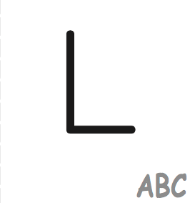





Example Activity:
I Have Who Has Letter Names
Icon side UP!
Deal a few cards to each “player,” icon side up
Start with any card, reading from the icon side:
“I have _____” (flip card over), “Who has ____?”
Place card on the paper plate
Each person scans to find that card—when they find it, they say, “I have _____” (flip card over), “Who has ____?” and play continues until all cards are flipped over
Notes:
Teacher: (Note: You may wish to only talk about this and have parents play it later at a center. But it’s much easier to understand it if you play it!)
One type of game we play to support reading and math skills is called I Have Who Has. I Have Who Has Letter Names helps children learn letter names. The neat thing is, children don’t have to know letter names before they play it—because there are supports for them built into the game. Like all Tools of the Mind activities, the development of self-regulation is built into the game. Children learn to take turns and to pay attention to visual cues while playing.
(Pass out the cards to parents—not everyone may end up with one but that’s okay.)
Normally we play this game in a small group so everyone can see the cards. The first thing to remember is to look at the cards icon side up—so make sure the corner that says “ABC” is showing. One person starts by saying “I have” and naming what’s on their card. Then they flip the card over and ask “Who has (blank)?” If you have that card, you say so and the process repeats. When you play in a small group, when you ask “Who has?” you put the card on a special place in the middle of the table where everyone can see it. So kids know what they’re looking for (even if they don’t know the letter name already). Children help each other if they get stuck.
Once children are familiar with their letters, they’ll work on playing the game faster and faster until the letter names become automatic.

Slide 12
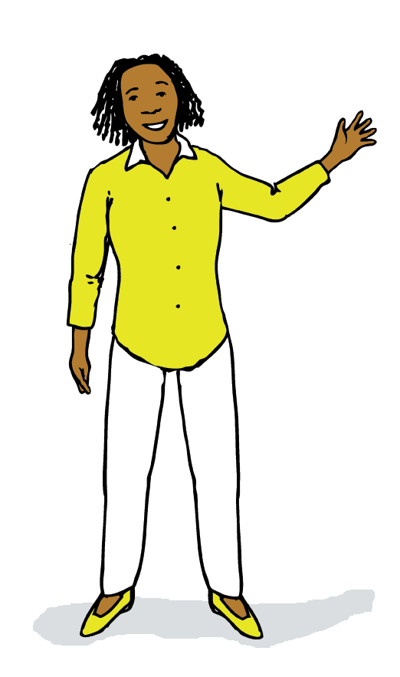
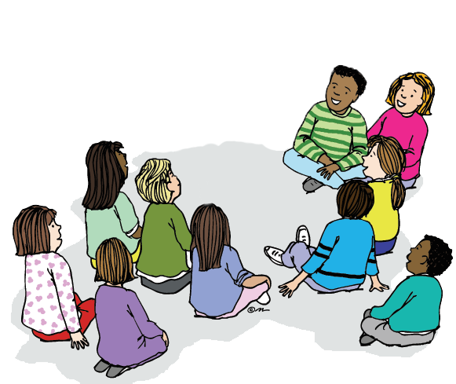
Example Activity:
Message of the Day
We are going to jump.
Notes:
Teacher: Every day I have a message for students. I use it to model the writing process. Children learn the first step in writing is having an idea—and remembering that idea. So I tell them a sentence, and they say it with me to get it into their memory. Then I model a writing process that starts with drawing one line for each word, then going back to add letters. We call this writing process Scaffolded Writing.
Children learn to focus their attention closely while saying the message aloud as I point to each line. They’re using working memory to remember the message and remind me what to write (all executive functions).

Slide 13
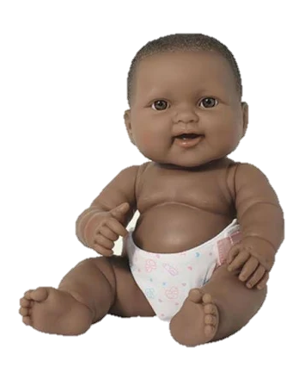

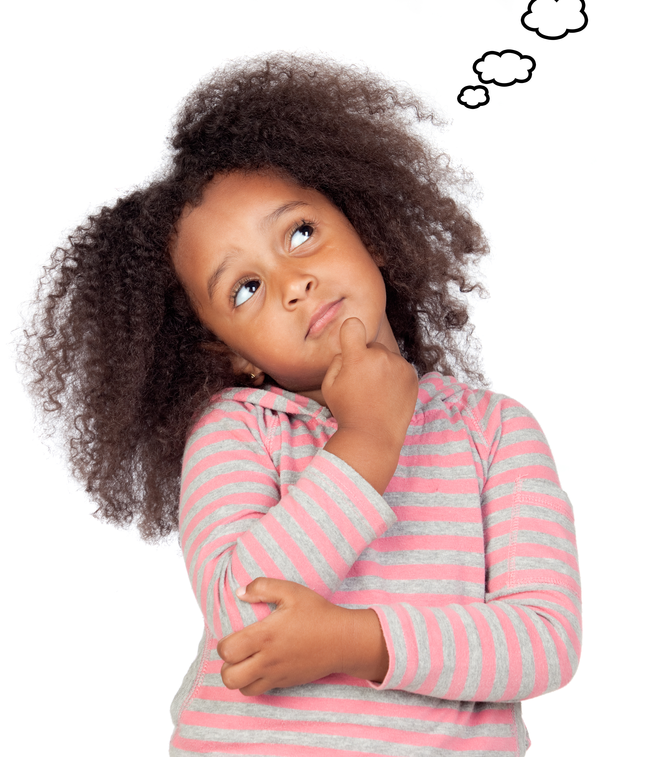
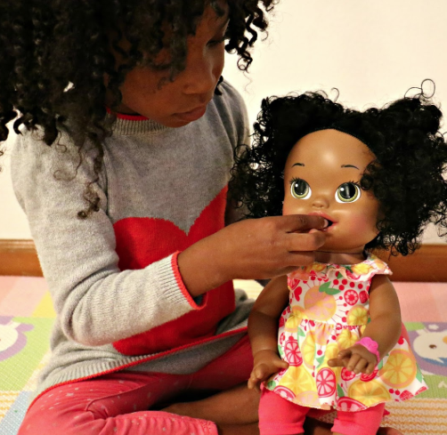
Example Activity: Play Planning
Notes:
Teacher: Children do their own Scaffolded Writing every day. They make a Play Plan—a plan for what role they will be in Make-Believe Play that day, and what actions they will do in that role. Play Planning develops self-regulation by helping children make a plan before they act. Pausing to think about what’s going to happen next and making a plan for what you’ll do is an important self-regulation skill.
In this example, the child is going to the Family Kitchen center. She decides she’d like to play a parent feeding a baby. She puts her idea down on paper, then goes off to the Center to do what she imagined.

Slide 14
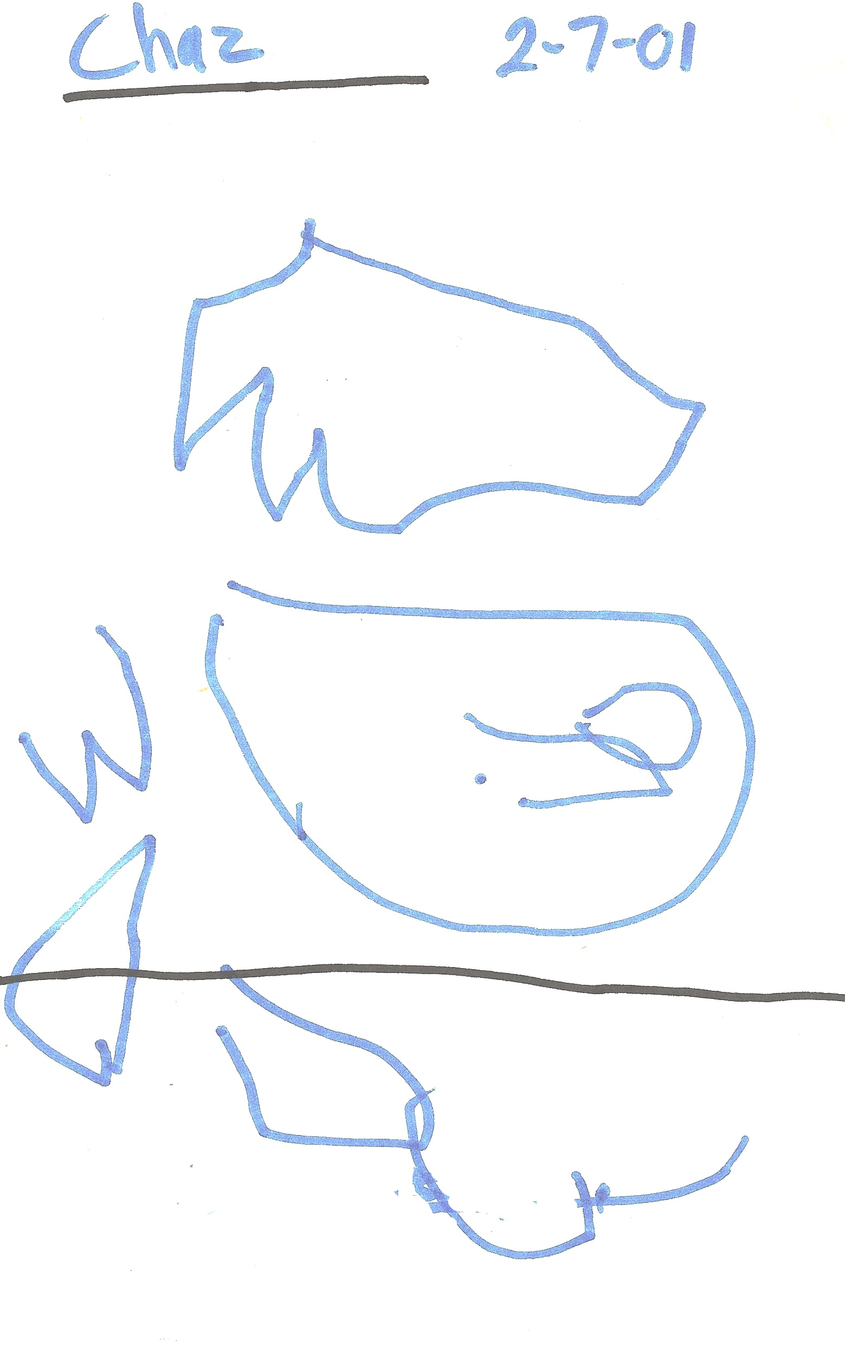
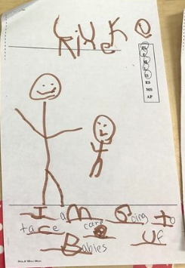
Example Activity:
Play Planning
Development over time…
Notes:
Teacher: Play Planning is also a literacy activity. Writing starts with drawing. Over time, children start to write lines for their words, and then some letter sounds. These writing samples give you a sense of how children’s writing progresses over the year.
When children begin to draw and write, it looks like this (far left)—lines and scribbles. These marks are meaningful to the child who wrote them, and are the beginning of representing thoughts on paper. Over time, lines become shapes and then recognizable pictures and letters.
We are teaching children not only letter names and sounds, and how the writing process works, but WHY we read and write—we read and write to share ideas and help us remember.

Slide 15
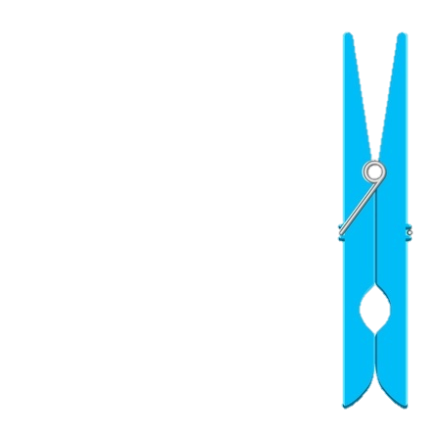
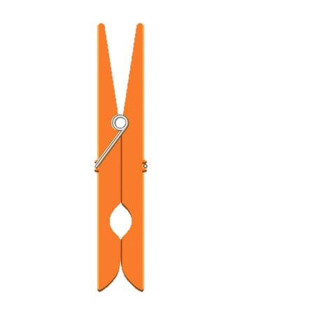
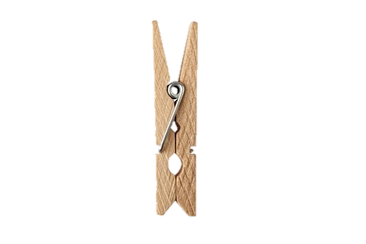
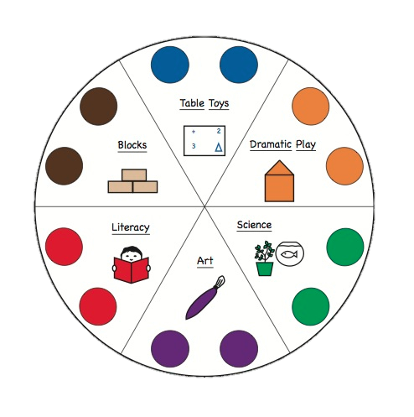
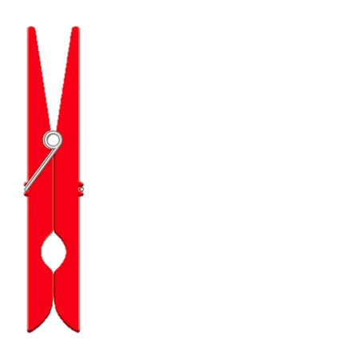
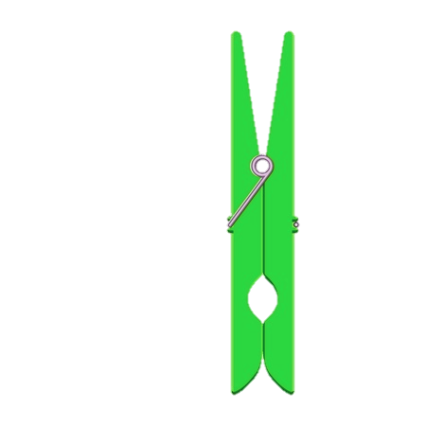


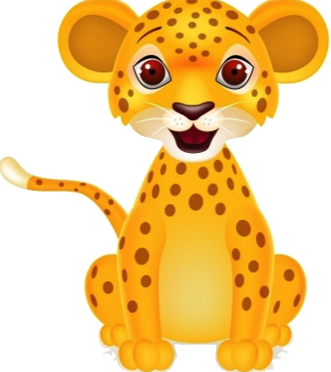
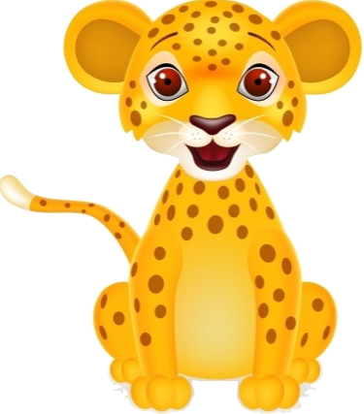

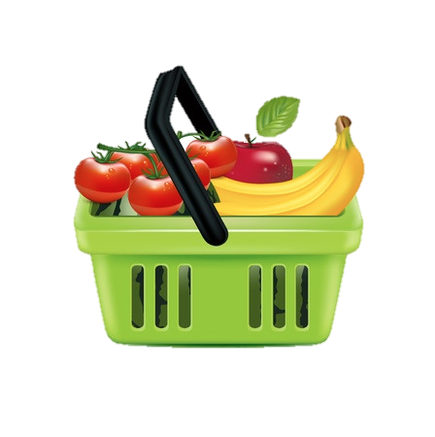
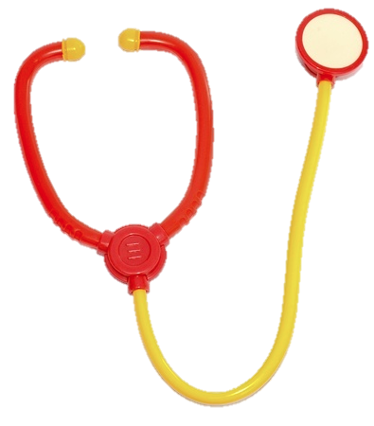
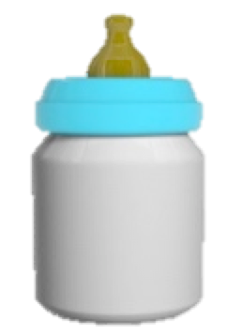

Make-Believe Play Themes
Family
Grocery Store
Restaurant
Hospital
Pet/Vet
And more!
Notes:
Teacher: And after children write their Play Plan, they go off to their Center to play. There are 5 themes most classrooms do (you can read them here), and then we also create our own themes (you can name some examples if you have ideas).
Children use a combination of props they have created themselves, along with store-bought props, to act out roles and situations. The props are different at each Center, so in the course of a week, children go to 5 different Centers to play.

Slide 16
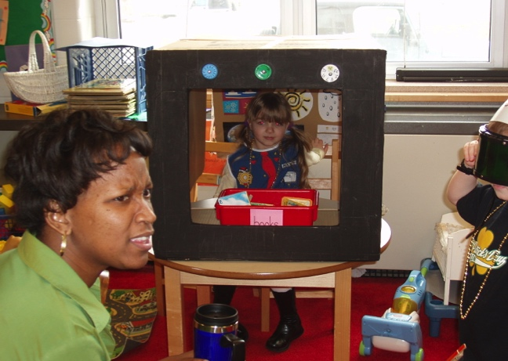
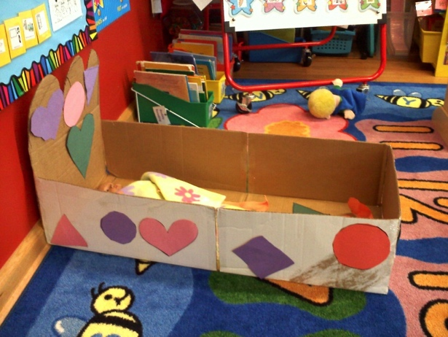
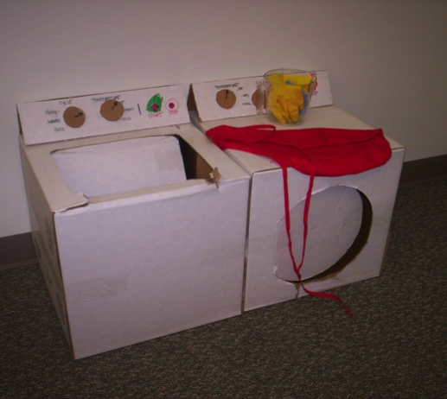
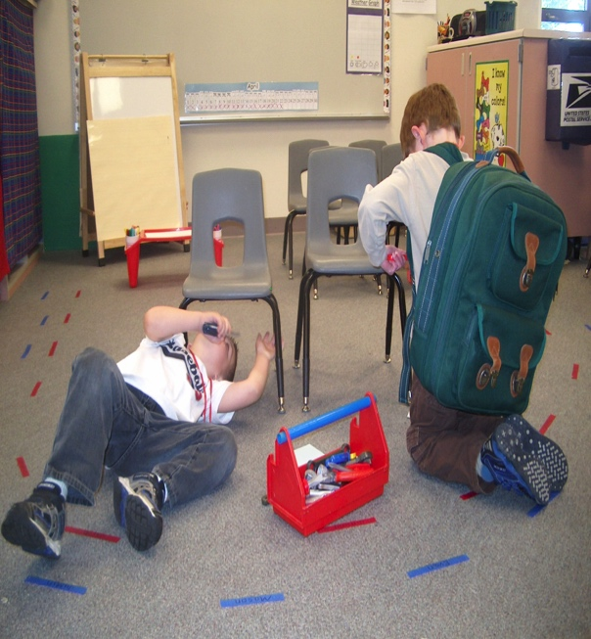
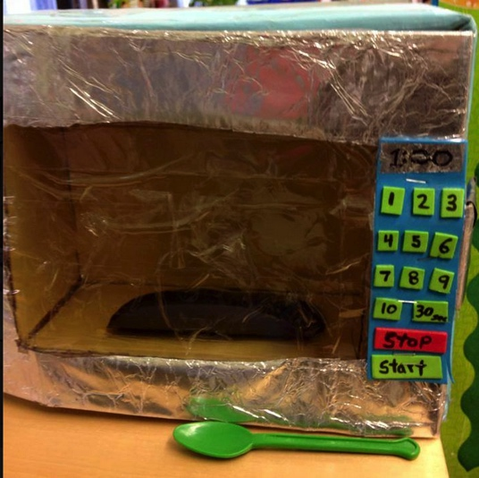
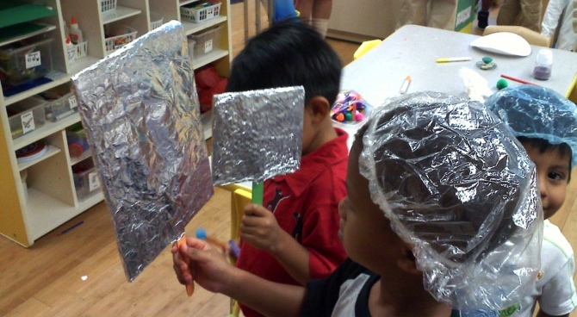
Example Play Theme: Family
Living Room
Bedroom
Laundry Room
Bathroom
Kitchen
Garage
Notes:
Teacher:
One Center is the Living Room, another is the Bedroom, the Laundry Room, the Garade, the Bathroom, the Kitchen. What are the kids doing in the garage? How are they using props? (the chairs are cars; the “adult” is under the car and the “child” hands them tools) What about in the bathroom—what are they doing? What props do you see? (the children made mirrors with tin foil and popsicle sticks)

Slide 17







What skills are developed in make-believe play?
Math Skills
Pre-Reading &
Pre-Writing
Self-Regulation
What would you like to order from the menu?
I’ll feed the baby first, you can be next.
Okay. I’ll change his diaper, too.
comparing volume
Language &
Vocabulary
This parcel needs more postage!
counting
Notes:
Trainer: Here are a few examples of the many skills we develop through make-believe play—a range of math skills (comparing volume and counting are just a couple of examples), self-regulation skills (turn taking, regulating others, and more), pre-reading and pre-writing skills (through meaningful literacy experiences in the context of play), and language and vocabulary skills (again, through meaningful play experiences).

Slide 18


How do we approach
Math and Science?
Small group, hands-on
Connections to play theme vocabulary and scenarios
Children learn roles and regulate each other
Notes:
Teacher: Let’s take a look at Math and Science in the Tools approach.
Our Math and Science activities take place in small groups (is that always true??) and often connect to the current play theme. Again, connecting to the play theme is motivating for kids, and it also lets them get more practice using the language and vocabulary that goes along with that theme.

Slide 19





Example Activities:
Numerals Game & Science Eyes
Notes:
Teacher: Here are a math and a science activity children will do later in the year. The Math activity is called Numerals Game, and is a way children practice counting, learn to recognize numbers, and learn to check their work. Again, that’s an example of how we build self-regulation into every Tools activity—checking our work is an important executive function skill. They play this game with a partner, and they use these Hand and Check cards to remind them what role they have. The Hand is doing the counting, the check is checking the work.
In Science Eyes, children explore different collections of objects using their senses. The magnifying glass is their mediator in this activity, to help them focus their attention and know whose turn it is.

Slide 20


How can I support
self-regulation development
at home?
Set up routines that get children involved
in remembering steps in a sequence, and planning what comes next!
Notes:
Teacher: The next 3 slides offer suggestions for bringing Tools strategies into our homes.
When our children are tiny, we do everything for them—and when they get older, sometimes we keep doing things for them that they could be doing themselves! It can seem faster to put their shoes and coat on for them rather than having them do the steps. But then we lose the opportunity for children to learn to do the task independently. You saw that in Tools we use visual mediators a lot—like the Hand and Check cards—so children can remind themselves what to do. You can use visual mediators at home in this way, too. Instead of reminding your child of every step they need to remember for getting on their outside clothes in the winter, make a visual mediator. You’re helping your child in so many ways—building their working memory, helping them learn to follow directions, and increasing their independence.
If your child doesn’t already have chores they’re responsible for, create a simple chore chart with a few age-appropriate jobs.

Slide 21



Encourage children to talk to use visual mediation, and
talk to themselves to remember!
You just ate breakfast, Maria.
Let’s look at the sign.
What comes next?
Oh—I still need to put my dishes in the sink!
Notes:
Teachers:
Encourage children to talk to themselves—in Tools we say that we “talk to remember,” and “talking is thinking.” We want children to think out loud. It’s a memory strategy!
You can encourage your child to repeat something to themself to remember it-–like if you ask them to go put on their shoes, you can say, “Say it to yourself: put on my shoes.” This puts them in charge of remembering and helps them develop a strategy for remembering. As they get older, the thoughts they said out loud—which we call private speech—become thoughts they say to themselves silently.

Slide 22









Supporting the play theme at home
Show the play themes throughout the year
So parents know what’s coming—can tell them about order of events
Can read books at home related to play
Play with them at home
Clean up song and pretend transitions slide for home-school connections
Engage in make-believe play
at home!
What could this box become?
I know! It could be a bath tub. Let’s give the baby a bath!
Notes:
Teacher: Encourage your child to act out our current play theme at home—and to come up with new ones! Boxes and other recyclables are great for making props. See what your child comes up with!
Reading books connected to our themes is another great idea (see next slide…).

Slide 23



Resource: Toolsofthemind.org
Notes:
Trainer: You can look at our Tools of the Mind website “Tools Store” page for prop and read aloud book ideas.

Slide 24






And of course…
read together!
Have your child help you turn the pages
Run your finger under words to model left to right sweep
Take turns “reading” pages
Talk about what you read (favorite parts, big ideas, retell)
Notes:
Teacher:
You already know how important it is to read with your child! Read a wide variety of books--picture books (fiction and non-fiction), chapter books, and don’t forget about wordless books (examples are on the right). Children enjoy telling the story they see in the pictures. Even before your child knows any letter sounds or recognizes any words, they can still “read” books to you!
There are so many ways we lay the foundation for reading while reading aloud to our children, without even knowing it. Children learn that in English we read books from left to right—we flip the pages in that direction. Have your child help you turn the pages. Run your finger under words as you read so your child learns that text goes in a left to right direction. Take turns “reading” pages (using illustrations to help pre-readers tell the story). At the end of the story, talk about what you read—it could be a favorite part, something funny, a character you liked. Your child might even want to retell the whole story by looking back through the pictures.

Slide 25


Self-regulation is a work in progress…
Notes:
Teacher: We are all practicing self-regulation—kids and adults! Developing self-regulation is a life-long process. Children are supposed to get mad, be unreasonable, have temper tantrums, not listen…and it takes a lot of patience to be a parent! This year, we will build a strong foundation of self-regulation, social skills and academic skills that your child will carry forward throughout their childhood and beyond.

Slide 26

We’re off to a great start!
Notes:
Teacher: The direction we’re headed in is happy, self-regulated, well-adjusted children who are ready to learn and to be good citizens of the world!
(You may wish to insert a class photo here to end the presentation.)

Slide 27
Optional slides:
independent activities for parents to explore at Centers
If you’d like to have parents explore some Tools activities independently tonight, you can share the following slides and prep the materials they’ll need to do them. A good place to share these is after you lead parents in the Message of the Day activity.
You could also have these activities out as parents arrive for Back to School Night, and give them a quick explanation of how to do them then.
Have role and action cards, Let’s Pretend books and other theme-building books out at Centers along with props and sets. Parents can browse and get a feel for how the centers are layered with materials.

Slide 28




Your Turn! Small Group
I Have Who Has
Icon side UP!
Deal a few cards to each “player,” icon side up
Start with any card, reading from the icon side:
“I have _____” (flip card over), “Who has ____?”
Place card on the paper plate
Each person scans to find that card—when they find it, they say, “I have _____” (flip card over), “Who has ____?” and play continues until all cards are flipped over
Notes:
Throughout the year, we use an activity called “I Have Who Has” for children to develop fluency in skills like recognizing colors, shapes, numbers and letters.
If you wish to, have a small group activity time for parents after you give your presentation (or you could even do it before).
It works well to introduce the games briefly before parents go play them. Show parents a sample set of cards (colors and numbers are good ones to start with) and walk them through the steps, drawing their attention to starting with the cards icon side up, and using the discard plate. It’s also a good idea to print the summary of I Have Who Has rules at the end of this slide deck and put it at that center with the parents.

Slide 29


Your Turn!
Mystery Games
?
We start the year with simple yes/no questions….
then move on to more challenging ones, including Mystery Math questions!
What will be your Mystery Question tonight?
Please use your child’s name tag to answer the question.
Notes:
Set up a Mystery Math question for parents to answer. They can find their child’s name card and answer on their behalf! The following day, you can leave up the parent’s choices and have children check their parents’ work (how’s that for other-regulation!).
Tell parents: Every day as part of the morning routine as children come in and get settled, they answer the question of the day. We start the year with simple yes/no questions, like “Are you wearing red?” We post the same question multiple days in a row to give children a chance to get used to it—we might only change where we put the yes and no! As the year goes on, we introduce more and more questions on different topics, including math. In the example you see here, Mystery Shape, the children try to figure out which two shapes can be put together to form the target shape they see at the top (the circle). We put out paper shapes so the children can manipulate them to figure out their answer. (Note to teachers: don’t worry if this activity doesn’t sound familiar—it’s not introduced until Training We actively encourage children to work together, and later in the day we talk about the question and decide together what the correct answer is. Tonight, please use your child’s name tag to answer the Mystery Question. Tomorrow, your child will see how you answered!
Sample Mystery Question to post:
Whatever question you’ll be asking children the next day
The the question you’ll ask the children the next day, with a twist (like, adding the “not” symbol, or adding “and” and another word (“Are you wearing blue AND you’re a Dad?”)—something to ramp up the challenge level a bit! And demonstrate how a simple activity can quickly get more complex)

Slide 30

Your Turn!
Play Planning
Visit your child’s Center
Draw & write a plan
for playing there!
“I am going to…”
Notes:
Teacher:
Have parents draw/write a play plan for when their child gets home tomorrow after school. I am going to play __ with you. I am going to read with you; I am going to cuddle with you; I am going to brush teeth with you… (give them the I am going to stem – teach them to draw the lines first and then write the words on the lines and draw a picture first.)
they’ll do there tomorrow (parents don’t have to write lines for their words—although they certainly can!). The next day, read the parents’ play plans to their children!

Slide 31

Handouts to Print for Optional Parent “Your Turn” activities
I Have Who Has Rules
I Have Who Has Rules
Notes:
Rules to print out and put at tables along with I Have Who Has cards.

Slide 32
Notes:
Parent alphabet chart—you may want to print out copies for parents to take home. It has the key words we use to access sounds, but unlike the Sound Map children used, it is organized traditionally/alphabetically. (The Sound Map is copyrighted and may not be reproduced to share beyond the classroom.)

